Slide 1
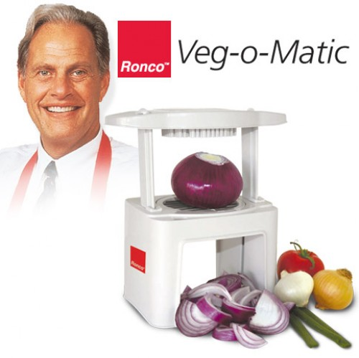
MCB 135 Lecture 2 Logic and Turing Completeness

Slide 2
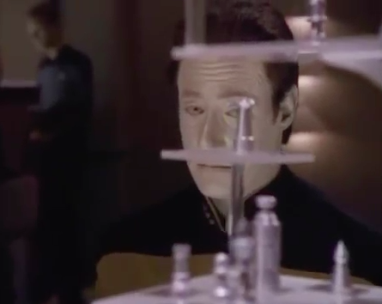
The human brain was once considered unbeatable
The android Data (b. 2338) vs. a novice chess player
Aired in 1992
Notes:
Only a generation ago, many people felt that computers could never rival the human mind. Some tasks were considered too creative to be performed by a computer.

Slide 3
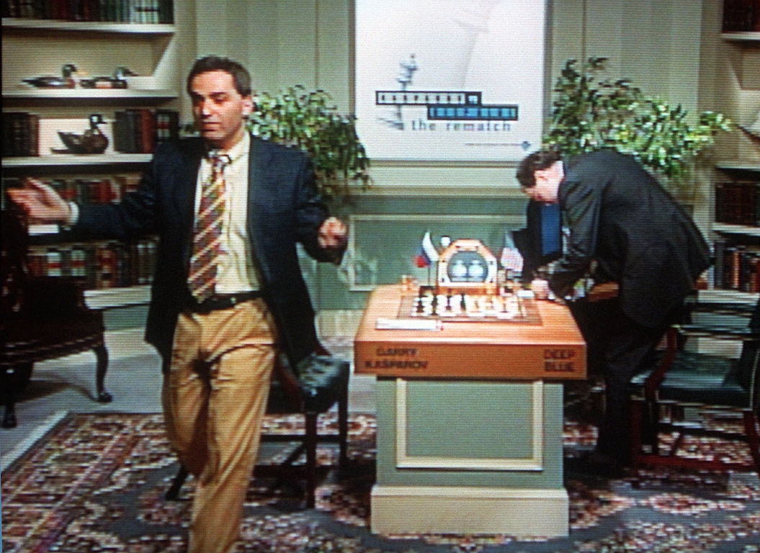
The tables are turning
IBM’s Deep Blue vs. (former) World Chess Champion Garry Kasparov
Rematch of 1997

Slide 4
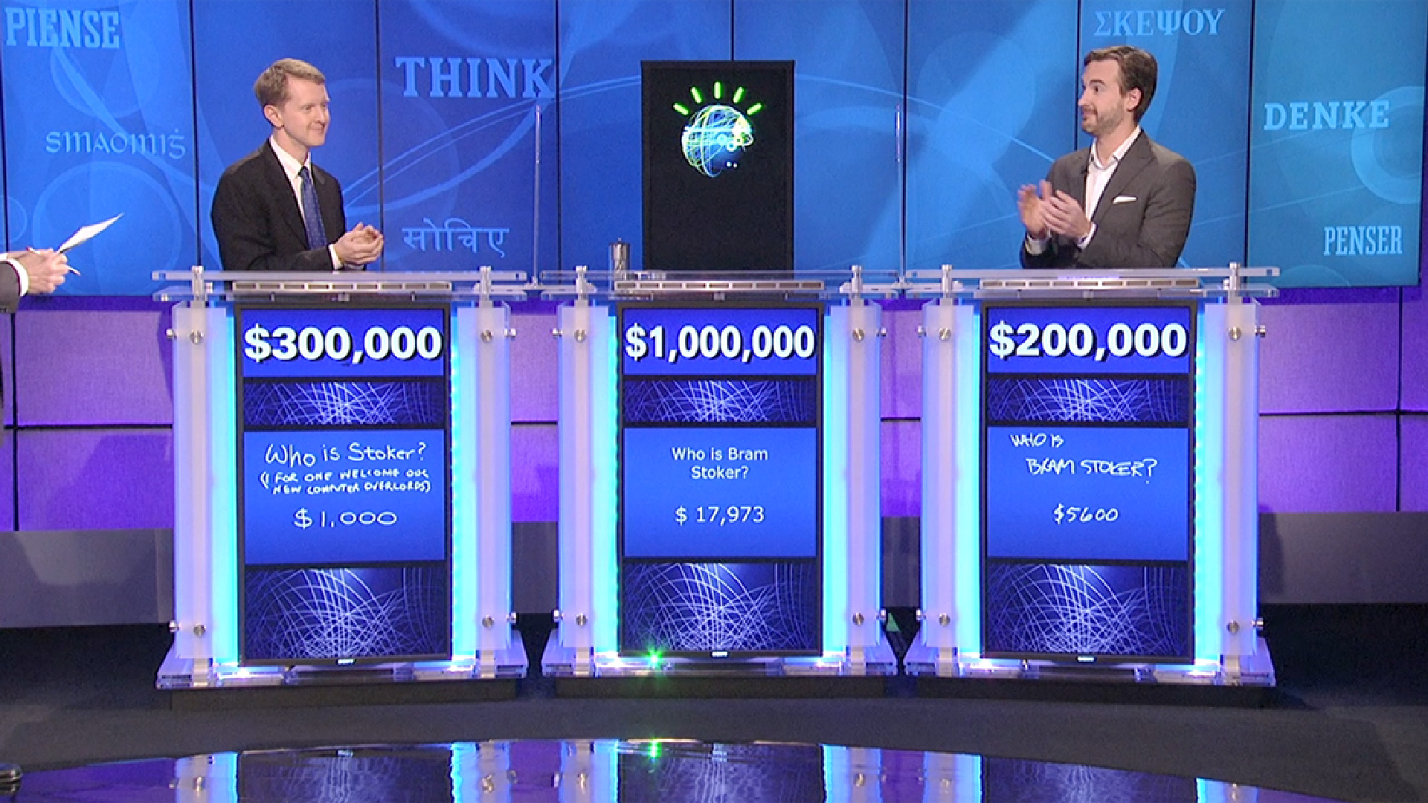

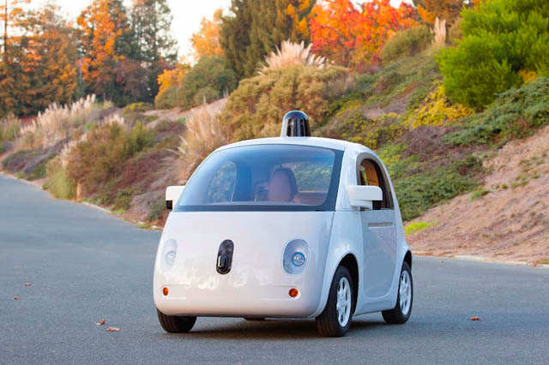
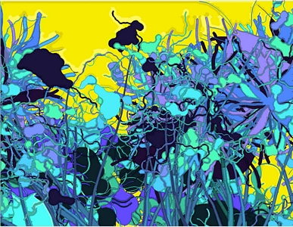
The tables are turning
Notes:
IBM’s Watson
Call centers
Google’s driverless car: allowed to test in a half-dozen or so states so far. You can tell it’s not dangerous because it looks so adorable.
AARON, an artistic automaton
Now we’re more likely to ask whether humans can do everything that computers can do.

Slide 5
Today’s Outline
What is Turing completeness?
General description of a Turing machine
Example: a binary counter
Universality and Turing completeness
Abilities and limitations of Turing machines
Proving Turing completeness
Boolean functions and logic gates
Memory
Example from the Game of Life

Slide 6
Turing machine description
Infinitely-long tape divided into squares
Each square can contain exactly one symbol from a finite alphabet
A movable head that can read/write on the tape
A register with a finite number of states
A table of instructions specifying what actions to take for all combinations of internal state and current tape symbol
S
M
Q
P
c
Notes:
In particularly, the number of squares on the tape is countably infinite, since we could map them to the natural numbers.
The first three points help give the reader an impression of the machine as a physically-realizable object. The next feature (the state register) was a novel concept at the time of its introduction but is now a common idea.
To define the starting conditions for the machine, we need to specify the pattern of symbols on the tape, the position of the head, and the initial internal state.
The instructions can be moving the head left or right one square; reading, writing, or erasing a symbol on the square underneath the head; changing the state; or halting.

Slide 7
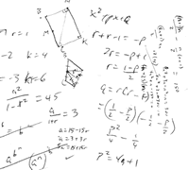
Why is this “design” sensible?
The tape is a source of input, one option for output, and also a form of memory
Finite alphabets and states are no limitation since the tape is infinite
Back-and-forth head movement allows the machine to read/write memory

Slide 8
Example Turing machine: A (binary) counter

Slide 9
Decimal vs. binary numeration
In decimal, possible digits are 0-9 and place values are powers of ten.
1101 = 1 x 10³ + 1 x 10² + 0 x 10¹ + 1 x 10⁰ = 1000 + 100 + 1
In binary, possible digits are 0 or 1 and place values are powers of two.
1101 = 1 x 2³ + 1 x 2² + 0 x 2¹ + 1 x 2⁰ = 8 + 4 + 1
Decimal
1
2
3
4
5
6
7
8
9
10
Binary
1
10
11
100
101
110
111
1000
1001
1010

Slide 10
“Counter” Turing Machine
Two internal states:
“S” for scanning right
“C” for incrementing the counter
Three tape symbols:
“ “ (blank)
“0”
“1”
Sample initial conditions:
S
0

Slide 11
“Counter” Turing Machine
Update rules:
(S, “ “)
(S, “0”)
(S, “1“)
(C, “ ”)
(C, “0”)
(C, “1”)
→
→
→
→
→
→
Move head left; change state to C
Move head right
Move head right
Write “1”; move head right; change state to S
Write “1”; move head right; change state to S
Write “0”; move head left
S
0
What will the Turing machine do next?

Slide 12
“Counter” Turing Machine
Update rules:
(S, “ “)
(S, “0”)
(S, “1“)
(C, “ ”)
(C, “0”)
(C, “1”)
→
→
→
→
→
→
Move head left; change state to C
Move head right
Move head right
Write “1”; move head right; change state to S
Write “1”; move head right; change state to S
Write “0”; move head left
S
0
What will the Turing machine do next?

Slide 13
“Counter” Turing Machine
Update rules:
(S, “ “)
(S, “0”)
(S, “1“)
(C, “ ”)
(C, “0”)
(C, “1”)
→
→
→
→
→
→
Move head left; change state to C
Move head right
Move head right
Write “1”; move head right; change state to S
Write “1”; move head right; change state to S
Write “0”; move head left
C
0
What will the Turing machine do next?

Slide 14
“Counter” Turing Machine
Update rules:
(S, “ “)
(S, “0”)
(S, “1“)
(C, “ ”)
(C, “0”)
(C, “1”)
→
→
→
→
→
→
Move head left; change state to C
Move head right
Move head right
Write “1”; move head right; change state to S
Write “1”; move head right; change state to S
Write “0”; move head left
S
1
What will the Turing machine do next?

Slide 15
“Counter” Turing Machine
Update rules:
(S, “ “)
(S, “0”)
(S, “1“)
(C, “ ”)
(C, “0”)
(C, “1”)
→
→
→
→
→
→
Move head left; change state to C
Move head right
Move head right
Write “1”; move head right; change state to S
Write “1”; move head right; change state to S
Write “0”; move head left
C
1
What will the Turing machine do next?

Slide 16
“Counter” Turing Machine
Update rules:
(S, “ “)
(S, “0”)
(S, “1“)
(C, “ ”)
(C, “0”)
(C, “1”)
→
→
→
→
→
→
Move head left; change state to C
Move head right
Move head right
Write “1”; move head right; change state to S
Write “1”; move head right; change state to S
Write “0”; move head left
C
0
What will the Turing machine do next?

Slide 17
“Counter” Turing Machine
Update rules:
(S, “ “)
(S, “0”)
(S, “1“)
(C, “ ”)
(C, “0”)
(C, “1”)
→
→
→
→
→
→
Move head left; change state to C
Move head right
Move head right
Write “1”; move head right; change state to S
Write “1”; move head right; change state to S
Write “0”; move head left
S
1
0
What will the Turing machine do next?

Slide 18
“Counter” Turing Machine
Update rules:
(S, “ “)
(S, “0”)
(S, “1“)
(C, “ ”)
(C, “0”)
(C, “1”)
→
→
→
→
→
→
Move head left; change state to C
Move head right
Move head right
Write “1”; move head right; change state to S
Write “1”; move head right; change state to S
Write “0”; move head left
S
1
0
What will the Turing machine do next?

Slide 19
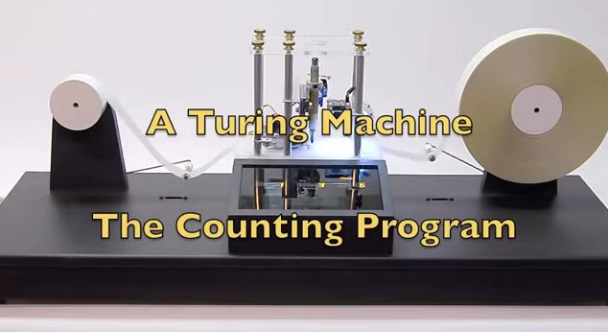
“Counter” Turing Machine
Notes:
A few differences: the initial state for this machine is “1011” which is eleven in binary. The program will write that on the tape before beginning.
The camera, marker, and eraser are unfortunately not exactly in the same position, so the tape will have to shift more than in our example for changes to be made.
Also the machine will periodically scroll the tape so that you, the viewer, can read the whole number.

Slide 20
Universal Turing Machines
…can behave like any arbitrary Turing machine by first reading its description off the tape.
By definition, any system that can emulate a universal Turing machine can do whatever a Turing machine can. Such systems are called Turing complete.
Soon we’ll show that biological systems are Turing complete, but first, let’s learn the limits of Turing machines.
Notes:
Nowadays when you buy a laptop, you expect that you can make it do whatever you need just by installing the right software. We will eventually ask, do living things have all of the necessary hardware to implement an arbitrary Turing machine. But first we should understand the implications of Turing completeness.

Slide 21
Is there a Turing machine for every problem?
Notes:
We will see that the number of Turing machines and the number of problems are both infinite, but one infinity is in a sense larger than the other.

Slide 22
Two sizes (cardinalities) of infinity
The natural numbers 1, 2, 3, … are countably infinite.
The real numbers are uncountably infinite.
What happens when we try to find a one-to-one correspondence between the natural numbers and the real numbers (even just those between 0 and 1, represented in binary)?
Notes:
To show that there are more real numbers than natural numbers, we’ll try to find a one-to-one correspondence (and fail). We’ll even use just a subset of the real numbers: [0,1]

Slide 23
Cantor’s diagonality argument: suppose a 1-to-1 map exists
1: 0.00111110101010101010101000010100…
2: 0.00101010110010010100101101010111…
3: 0.11101010011010101010101000101010…
4: 0.11010101111010101011101010011110…
…
Can you show that at least one real number between 0 and 1 is missing, for a contradiction?
Notes:
To show that there are more real numbers than natural numbers, we’ll try to find a one-to-one correspondence (and fail). We’ll even use just a subset of the real numbers: [0,1]

Slide 24
Cantor’s diagonality argument: suppose a 1-to-1 map exists
1: 0.00111110101010101010101000010100…
2: 0.00101010110010010100101101010111…
3: 0.11101010011010101010101000101010…
4: 0.11010101111010101011101010011110…
…
Define a real number so that its nth digit is the opposite of that digit in the nth real number:
0.1100…
This is a real number, but it appears nowhere in the list! Therefore the 1-to-1 map cannot exist.
Notes:
To show that there are more real numbers than natural numbers, we’ll try to find a one-to-one correspondence (and fail). We’ll even use just a subset of the real numbers: [0,1]

Slide 25
Suppose the tape alphabet has m symbols and there are n internal states.
What is the number of tape symbol/state combinations (entries in the instruction table)?
m x n

Slide 26
Suppose the tape alphabet has m symbols and there are n internal states.
What is the number of tape symbol/state combinations (entries in the instruction table)?
m x n
How many distinct action combinations can any given instruction have?
m x n x 3 x 2
Halt or not
Possible symbols to write
Possible movements
Possible next states

Slide 27
Suppose the tape alphabet has m symbols and there are n internal states.
What is the number of tape symbol/state combinations (entries in the instruction table)?
m x n
How many distinct action combinations can any given instruction have?
m x n x 3 x 2
How many Turing machines of this type are there?
6m²n²
…the total number is (countably) infinite.

Slide 28
How many problems are there?
A “problem” has a defined output for all possible inputs
The number of squares on one tape is countably infinite
The number of possible inputs is uncountably infinite, like the real numbers.
=> There are more problems than there are
Turing machines to solve them.

Slide 29
Some problems that can’t be solved with a Turing machine
Determining whether two arbitrary functions are equivalent
Determining whether a statement is valid given a set of axioms (Hilbert’s Entscheidungsproblem)
Determining whether an arbitrary Turing machine will halt or continue indefinitely given an arbitrary input

Slide 30
Still, Turing machines can compute quite a bit. The Church-Turing conjecture states that Turing machines can compute any function that can be calculated by “mechanical” means (no counterexamples in 75+ years)
Notes:
Unfortunately this conjecture will likely never be proven formally because “mechanical calculation” is poorly posed.

Slide 31
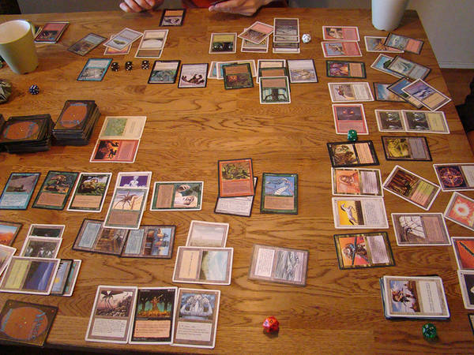

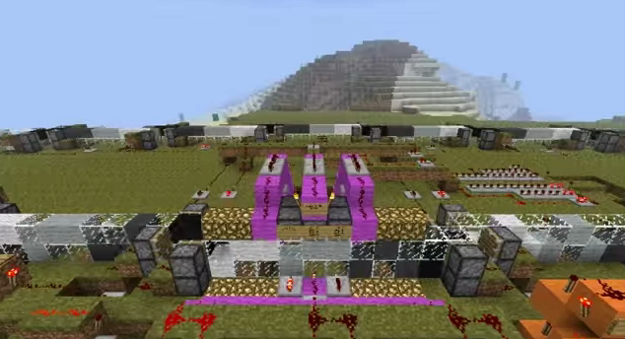
A system is Turing complete if it can:
Implement instruction tables in the form of Boolean functions (to be described shortly)
Implement arbitrarily-large memory
Notes:
Boolean functions here act as the instruction tables
Notice that we don’t require that the system be able to read in a description of a Turing machine in order to emulate it. We’ll suppose that the description of the Turing machine can be pre-processed and fed into the system in whatever form we desire. (You can make an argument that we have simply transferred computational difficulty to the pre-processor, but this usage is generally accepted.)
Magic the Gathering, the email server sendmail, and Minecraft all (evidently by accident) can do these things. But how can we show it?

Slide 32
We can describe all instruction tables using Boolean functions
The instruction table is a function that maps tape symbol/current state combinations (inputs) to combinations of actions (outputs).
We can enumerate all possible inputs as binary numbers, e.g., the inputs for the “counter”:
000: (S, “ “) 011: (C, “ “)
001: (S, “0”) 100: (C, “0”)
010: (S, “1”) 101: (C, “1”)

Slide 33
All possible outputs can be represented in binary as well
000000
000001
000010
000011
000100
000101
000110
000111
001000
001001
001010
001011
001100
001101
001110
001111
010000
010001
(“ “, C, left, halt)
(“0”, C, left, halt)
(“1”, C, left, halt)
(“ “, C, stay, halt)
(“0”, C, stay, halt)
(“1”, C, stay, halt)
(“ “, C, right, halt)
(“0”, C, right, halt)
(“1”, C, right, halt)
(“ “, C, left, continue)
(“0”, C, left, continue)
(“1”, C, left, continue)
(“ “, C, stay, continue)
(“0”, C, stay, continue)
(“1”, C, stay, continue)
(“ “, C, right, continue)
(“0”, C, right, continue)
(“ 1”, C, right, continue)
(“ “, S, left, halt)
(“0”, S, left, halt)
(“1”, S, left, halt)
(“ “, S, stay, halt)
(“0”, S, stay, halt)
(“1”, S, stay, halt)
(“ “, S, right, halt)
(“0”, S, right, halt)
(“1”, S, right, halt)
(“ “, S, left, continue)
(“0”, S, left, continue)
(“1”, S, left, continue)
(“ “, S, stay, continue)
(“0”, S, stay, continue)
(“1”, S, stay, continue)
(“ “, S, right, continue)
(“0”, S, right, continue)
(“1”, S, right, continue)
010010
010011
010100
010101
010110
010111
011000
011001
011010
011011
011100
011101
011110
011111
100000
100001
100010
100011

Slide 34
The instruction table is a function mapping one binary number to another.
A Boolean function takes a binary number as input and returns either “0” or “1”.
We can define a different Boolean function to specify each digit of the output.
The instruction table is completely described by this set of Boolean functions.
Input: 010
Output: 100011
f₁
f₂

Slide 35
Logic gates implement simple Boolean functions
OR
Variable number
of inputs
Each individual input/output is:
1 or 0
ON or OFF
TRUE or FALSE
One output (always)
AND
NOT
Notes:
Whimsical shapes help us

Slide 36
Logic gates implement simple Boolean functions
The “OR” gate
We can fully describe each gate by its output for each possible input combination
Input1 Input2 Output
OFF OFF OFF
ON OFF ON
OFF ON ON
ON ON ON
OR

Slide 37
Logic gates implement simple Boolean functions
The “AND” gate
We can fully describe each gate by its output for each possible input combination
Input1 Input2 Output
OFF OFF OFF
ON OFF OFF
OFF ON OFF
ON ON ON
Input1 Input2 Output
OFF OFF OFF
ON OFF OFF
OFF ON OFF
ON ON ON
AND

Slide 38
Logic gates implement simple Boolean functions
We can fully describe each gate by its output for each possible input combination
The “NOT” gate
Input Output
OFF ON
ON OFF
NOT

Slide 39
The last logic gate you’ll ever buy
AND
NOT
The “NAND” gate
Input1 Input2 Output
OFF OFF ON
ON OFF ON
OFF ON ON
ON ON OFF
Input1 Input2 Output
OFF OFF ON
ON OFF ON
OFF ON ON
ON ON OFF
=
NAND

Slide 40
You can implement any Boolean function using just NAND gates
NAND
Try it yourselves:
Can you make a two-input OR gate using just NANDs?
If so, come draw it!
The “NAND” gate
Input1 Input2 Output
OFF OFF ON
ON OFF ON
OFF ON ON
ON ON OFF

Slide 41
Reminder: the Rules of Life
Played on an
infinite 2D grid
Most squares
are ”dead” (dark)
A few squares
are “alive” (light)

Slide 42
Reminder: the Rules of Life
Played on an
infinite 2D grid
Most squares
are ”dead” (dark)
A few squares
are “alive” (light)
Played in rounds
Rules tell us when
a square will die
or come to life

Slide 43
Reminder: the Rules of Life
Live squares “survive” in the next round if they had 2 or 3 live neighbors in the last round
Squares are “born” in the next round
if they had exactly
3 live neighbors in the last round
These squares will be born in the
next round
These squares
will die in the
next round
Notes:
We get to be pretty arbitrary about what we define as inputs and outputs. I will pick certain squares on the board to be inputs: each of the squares can be on or off, so the combination of input squares can represent any binary number.

Slide 44
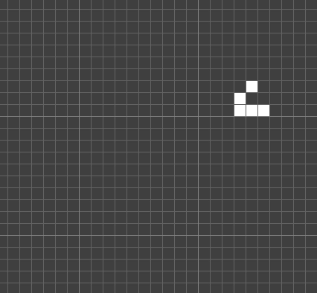
Gliders travel indefinitely: ideal for carrying signals
Notes:
What about something much more complicated, like this pattern that prints a message (the course number)?

Slide 45
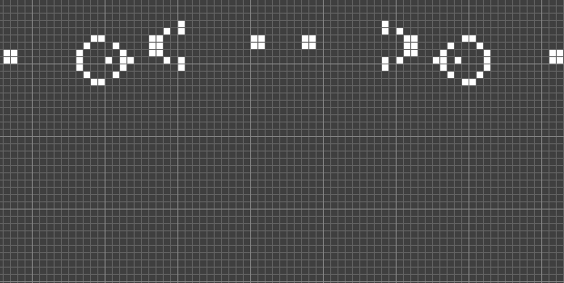
Gliders (here, fired from glider guns) annihilate on collision

Slide 46
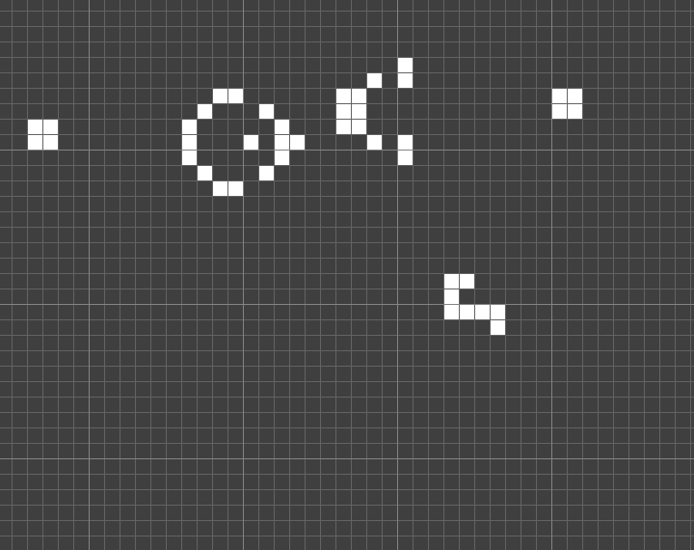

Binary input with the Gosper Glider Gun and stopper
On
Off
Notes:
It turns out that there is a particularly handy way to implement that in the Game of Life. There is a special pattern called a Gosper Gun which fires an infinite stream of gliders. When a stopper is in the way, the gliders hit it and disappear. However, if I add just one square to the blocker, the blocker will destroy itself, and the glider stream can escape.

Slide 47
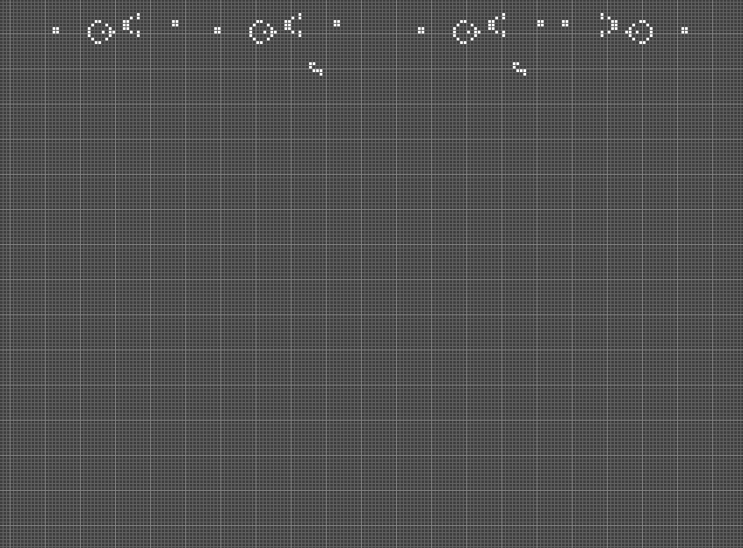
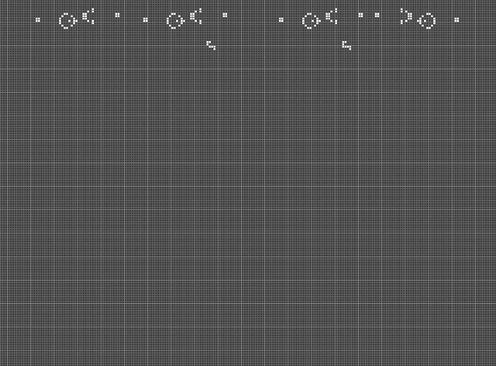
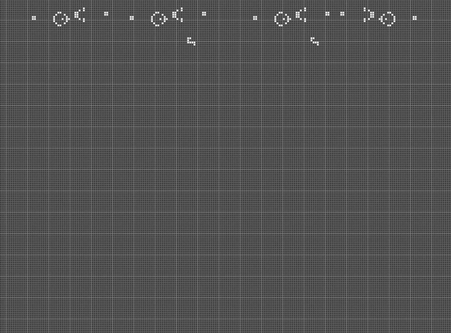
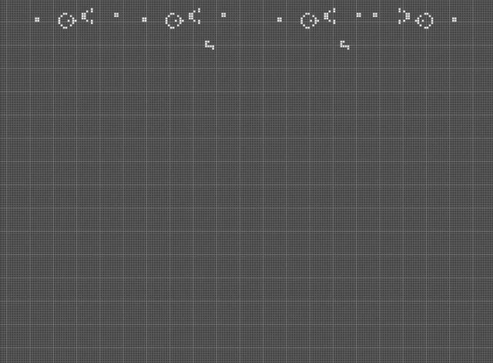
The OR gate implemented in GoL
OFF, OFF
OFF, ON
ON, OFF
ON, ON
Credit: Jean-Philippe Rennard
Notes:
If the square indicated by the red arrow ever turns on, then the output is ON. Otherwise, the output is OFF.

Slide 48
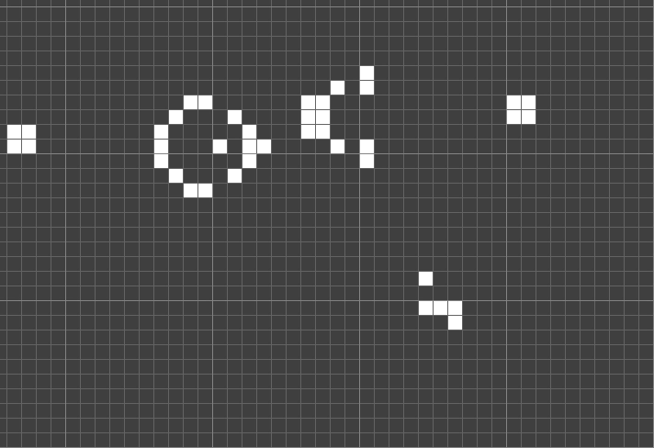
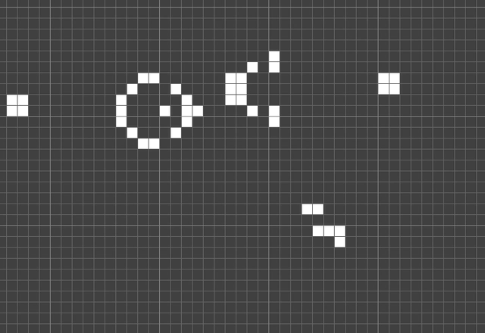
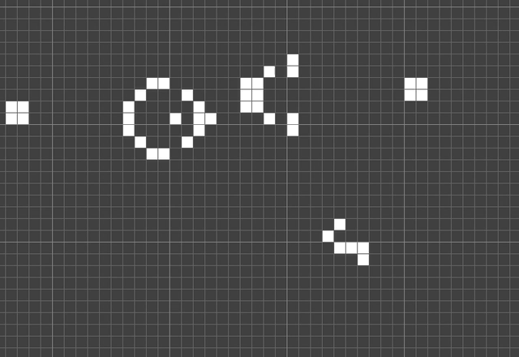
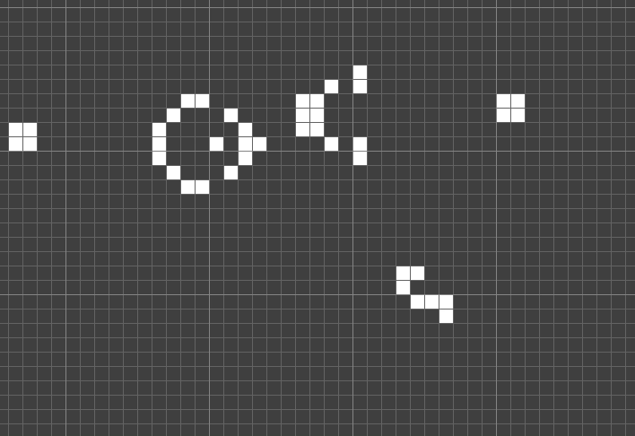
NAND gate implemented using two squares in a “stopper”
OFF, OFF
OFF, ON
ON, OFF
ON, ON

Slide 49
GoL can implement arbitrary Boolean functions, but can it implement memory?

Slide 50

Sliding Block Memory
A salvo of gliders can be used to push a block one square left or right.
The position of the block can be queried by firing another glider nearby.
If the glider makes it through, then the block must have been in a certain position.
Pattern by Dean Hickerson

Slide 51
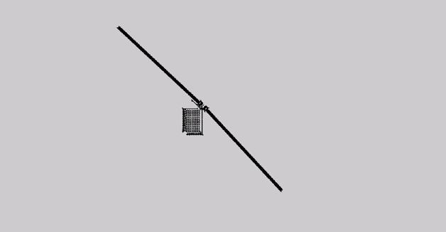
Quite literally emulating a universal Turing Machine in the Game of Life
Pattern by Paul Rendell (2010)

Slide 52
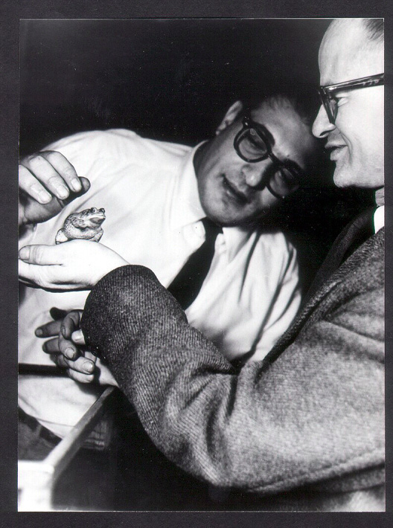

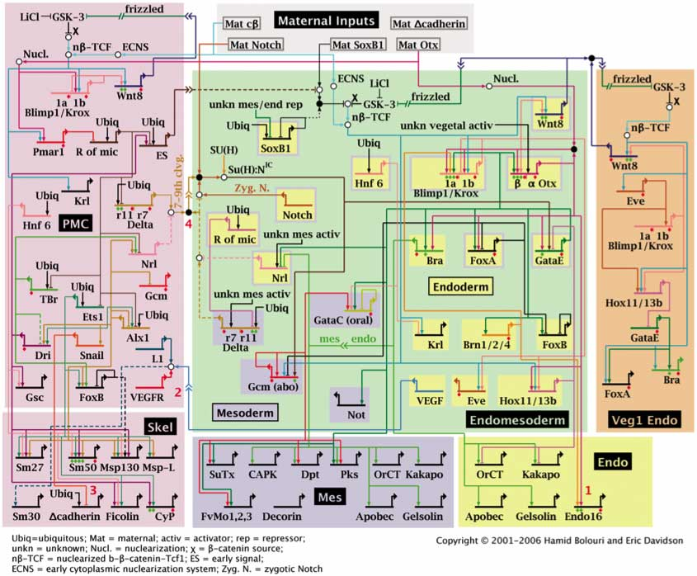
Next Time: Turing completeness in living systems Self-replication and the role of tape
Notes:
Walter Pitts and Johnny von Neumann

